Slide 1

August 2026
Why Do Economists Study Education?
ELP 390G | Week 1 | An Insider's View
Jeff Denning
Associate Professor, LBJ School & ELP, The University of Texas at Austin

Slide 2
What do you think of when you think of Economics?

Slide 3
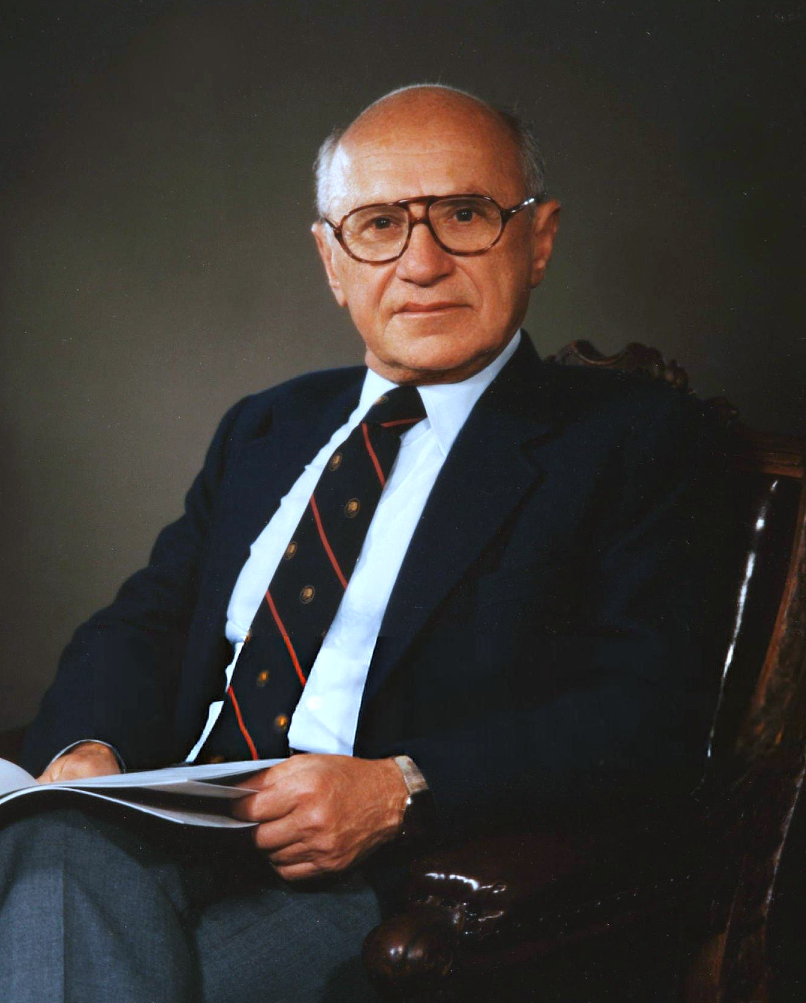


What do you think of when you think of Economics?

Slide 4
What is Economics?
No agreed upon definition
“study of markets”
“study of opportunity costs”

Slide 5
Unlike many disciplines it is not defined by a topic
E.g. Education/Finance/English departments are focused on topics from a variety of methodologies
Rather, econ is defined by methodologies
This includes economic modelling
Set of statistical techniques, “econometrics”
Leads to (accurate) accusations of “Economics Imperialism”
Economics now studies a lot of different topics

Slide 6
Implications
Economists study many topics that may surprise people
Fertility/Marriage
Health
Crime
Education

Slide 7
Why Education Specifically?
There are two main subfields in economics that study education
Labor Economics
Study of the labor market
Public Economics
Study of government
Industrial Organization
How firms interact with each other

Slide 8
Labor Economics
Tends to focus on individuals
Started with, how does education affect labor market outcomes?
Education has huge labor market effects
Eventually, researchers started digging into education production
How much do teachers matter for a student’s learning?
How does a magnet program effect a student?
How does financial aid for college affect the decision to go to college?

Slide 9
Public Economics
Tends to focus on government
Examples
How does funding affect the quality of schools?
How does the structure of the education market affect students? (e.g. do charters improve test scores of surrounding schools?)
What are the best ways to design school choice?
How do teacher’s unions affect education provision

Slide 10
Is it Labor or Public?
Often, there is no clear distinction
E.g. Do charters affect student test scores?
Or a paper will do both
How does a new loan program affect students’ graduation? How does it affect the way a school sets tuition

Slide 11
Activity: Labor or Public?
How do teacher’s aides affect student learning?
How does a student’s peers affect their decision to go to college?
How does accountability change the behavior of principals?
How do school vouchers affect student learning?

Slide 12
Other subfields also dabble
Behavioral Economics
How does changing the way that student loans are offered affect borrowing?
Macro
How do macroeconomic conditions affect investment?

Slide 13
Causality
Economists care (a lot, maybe too much) about causality
How does X affect Y?
Much of econometrics is focused on identifying causal effects

Slide 14
Causality 2
Many questions are causal
If I pay teachers more, how does it affect students?
Some are not
How are educational experiences different for white and Hispanic students?
Economists almost exclusively focus on causal questions
Means that they have blind spots.

Slide 15
Summary
Economists have something interesting to contribute to education research
Of course, they do not have a monopoly on insights (despite what they may say!)

Slide 16
Where This Shows Up in Our Course
Mostly labor economics:
Returns to schooling, class size, teacher effects, peer effects, aid and enrollment
Mostly public economics:
School finance, the incidence of student aid, accountability, charters and choice
Most weeks are both at once, which is the point
One economic idea, one policy area, and the evidence, every week
Week 5 is entirely about causality: causal or descriptive, and how to tell

Slide 17
Next Week: Scarcity and Tradeoffs
The idea: scarcity and tradeoffs. The policy area: school finance.
Jackson, Johnson & Persico (2015) on school spending and adult earnings
Hanushek (2015, 2016) on whether money matters, and what else does
Biasi, Lafortune & Schonholzer (2025) on school capital investment across the US
Problem Set 1 is due at the start of class on September 8

